Slide 1
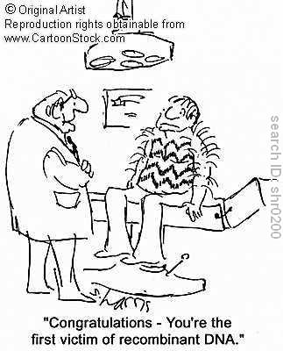
Molecular Genetics DNA

Slide 2
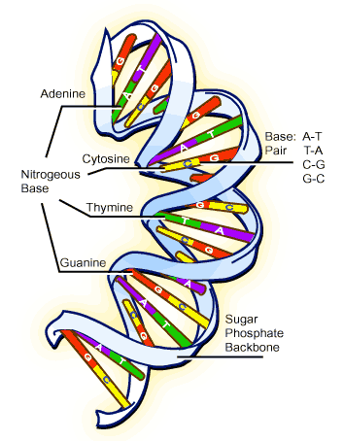
Structure
4 nucleotides (adenine, guanine, cytosine, and thymine (uracil – RNA))
Complementary base pairs
A=T/U
C=G
5 carbon sugar
Phosphate
Looks like a twisted ladder
Two strands are antiparallel
Franklin discovered the three dimensional look of DNA
Watson and Crick made the first 3-D model

Slide 3
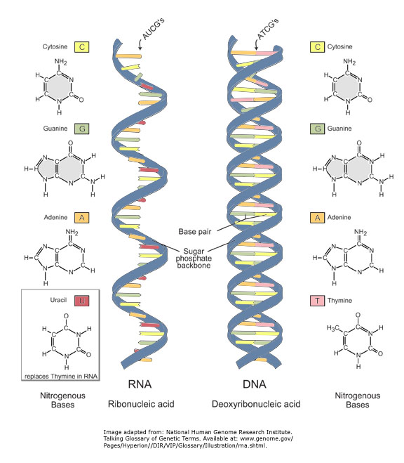
RNA vs. DNA
DNA
Deoxyribose sugar
Contains thymine
Double stranded
RNA
Ribose sugar
Contains uracil
Single stranded
DNA Structure Video

Slide 4
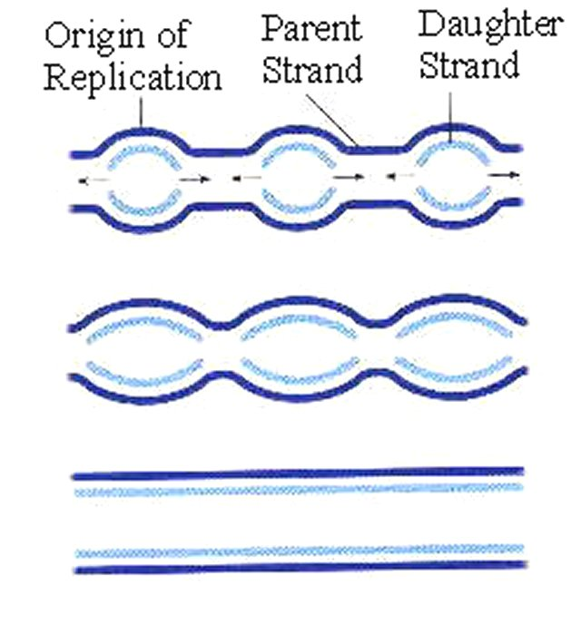
DNA Replication
Making a photocopy of DNA
Semi-conservative – one half of DNA is old strand and other half is new
Starts are replication origin (specific nucleotide sequence) – on strand will have many start points

Slide 5
Replication Steps
DNA Polymerase
like a truck that delivers the new nucleotides to old DNA
Proofreads
Will remove primer and replace with free nucleotides
Leading strand – replicated continuously
Lagging strand – in short segments – Okazaki fragments
Okazaki fragments glued together by DNA ligase
Enlongation only happens in 5’ to 3’ direction
Helicase – unwinds DNA
Single stranded binding proteins – act like tacks to hold the single strand of DNA down.
Primer – sets the start point (made by primase)
Replication Video

Slide 6
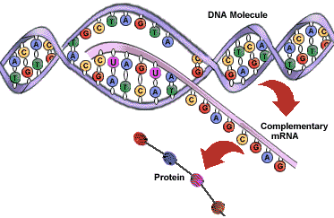
Protein Syntesis
Key terms
Codon
Anticodon
Transfer RNA
Messenger RNA
Transciption
translation
Transcription (nucleus)
DNA – copied to mRNA
Only one side of DNA is copied
Specific sequences of DNA nucleotides are starting points and stopping points

Slide 7
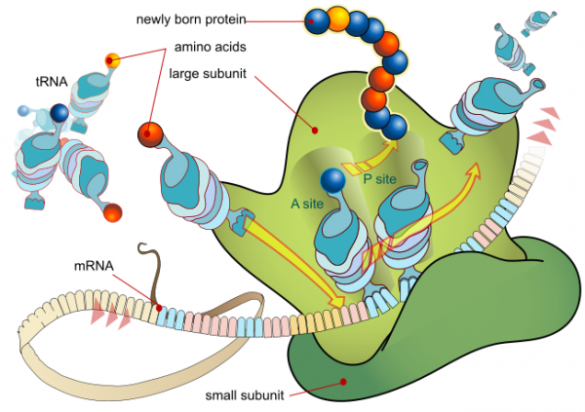
Translation
Happens in the cytoplasm
mRNA – tRNA (anticodons)
mRNA binds with ribosomes and tRNA brings in amino acids
Ribosome reads the mRNA like a reading a tape.
Gene to Protein Video
(Transcription & Translation

Slide 8
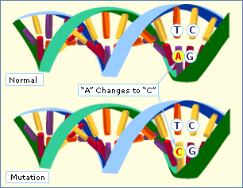
Mutations
Somatic cell mutations – are key cause of cancer
Germ line mutations – occur in reproductive cells and are passed on from one gen to the next
Point mutation
Sub of on nucleotide
Deletion/addition of one or more nucleotides

Slide 9
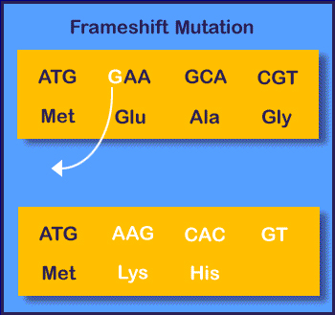
Point mutations
Silent mutation
There is no effect on cells metabolism
Mis-sense mutation
Altered protein – can have major issues (ex. Sickle cell anemia)
Nonsense mutation
Cannot code a functional polypetide
Frame shift mutation
Shift entire reading frame

Slide 10
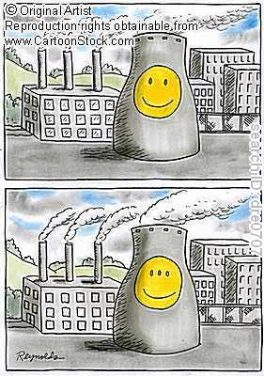
Causes of Mutations
Spontaneous
Takes place naturally in a cell
Induced
Caused by agents outside the cell
Physical Mutagens
High energy radiation
X-Rays, Gamma Rays
UV Rays
Chemical Mutagens
Carcinogenic
Mutation Video

Slide 11
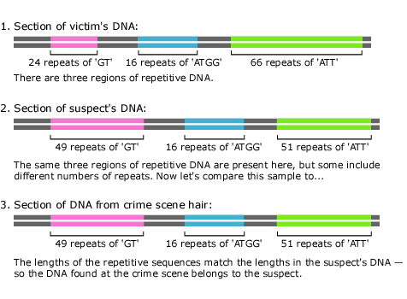
Analyzing DNA
Gel electophoresis – used to separate DNA fragments
DNA fingerprint
-crime scene
-parentage

Slide 12
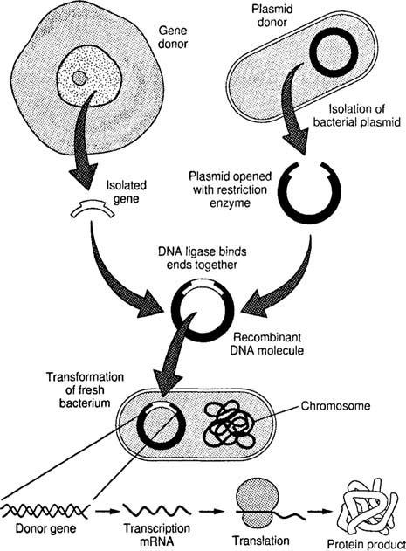
Recombinant DNA
A molecule that includes genetic material from different sources
Transgenic organism
Medicinal bacteria – help make insulin
Plants – to resist herbicides, pests, viruses
clones
Recombinant DNA Video

Slide 13
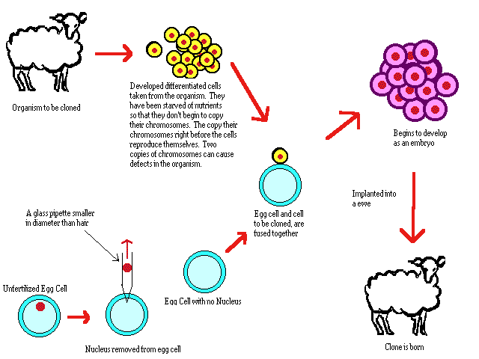
Cloning
Organisms that are completely identical to each other.
Dolly the sheep
Looking at trying to clone organs

