Slide 1
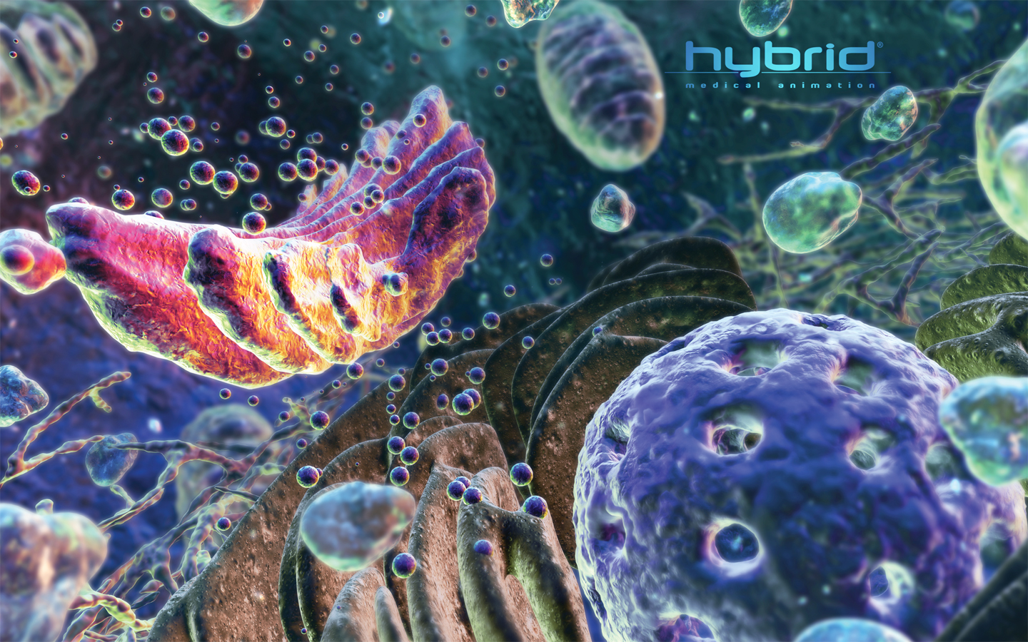
Cell Organelles
Outer protection
Cell control center
Energy center
Cell processing
Storage and Waste
Cell division

Slide 2
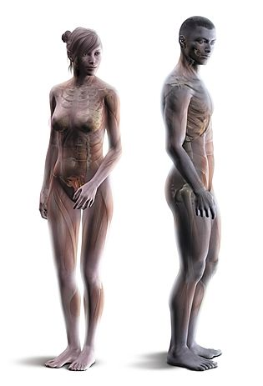
Organelle… the ‘mini organs’
Organs are specialized structures in the body that perform specific life processes (functions)
Organelles are specialized structures inside the cell (e.g. mini organs)
Organelles perform specific cell processes needed for a cell to live

Slide 3
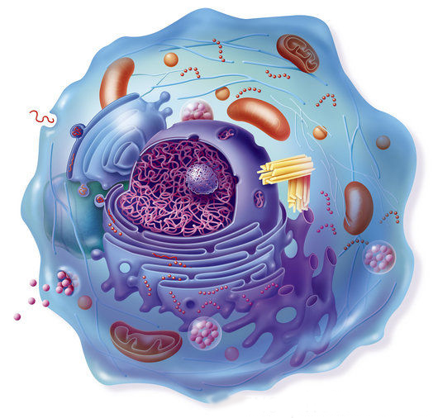
Cell Processes
All cells have to perform the same basic activities to stay alive:
  Use energy
  Store materials
  Absorb materials
  Eliminate waste
  Transport substances
  Reproduce

Slide 4
Cellular Components
Function | Organelle & cell parts
Outer protection | Cell wall, Plasma membrane
Cell control centre | Nucleus, nucleolus
Energy centre | Mitochondria, Chloroplast
Cell processing | Endoplasmic reticulum, ribosomes, Golgi body
Storage and waste | Vacuole, cytoplasm, chloroplast
Cell division | Centrioles

Slide 5
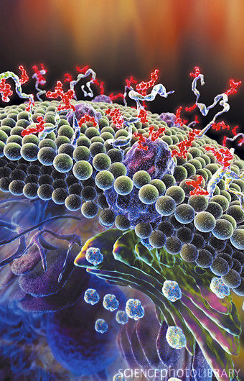
Cell Membrane Structure
All cells are surrounded by a flexible membrane
Also known as the plasma membrane
The membrane is made of a substance called phospholipid
Phospholipids also form the membranes around organelles

Slide 6
Cell Membrane Function
Controls exchange of material between interior of the cell and the external environment
Protection

Slide 7
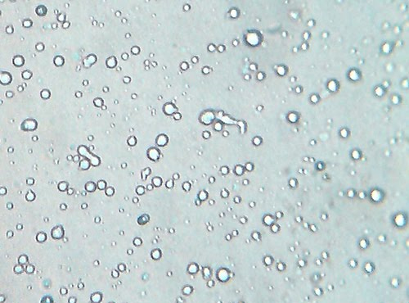
Cytoplasm
Mostly made of water
Can range from a liquid to a jelly-like substance
Contains dissolved substances
Cell organelles are suspended in the cytoplasm

Slide 8
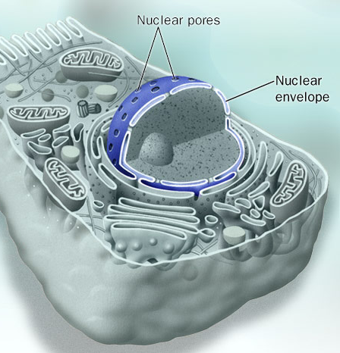
Nucleus
Control centre of the cell
Contains genetic information (e.g. chromosomes)
Contains nucleolus
Surrounded by a nuclear membrane
Nuclear membrane is double layered and has pores

Slide 9
Nucleolus
Darker area in the nucleus
Where ribosomes are made

Slide 10
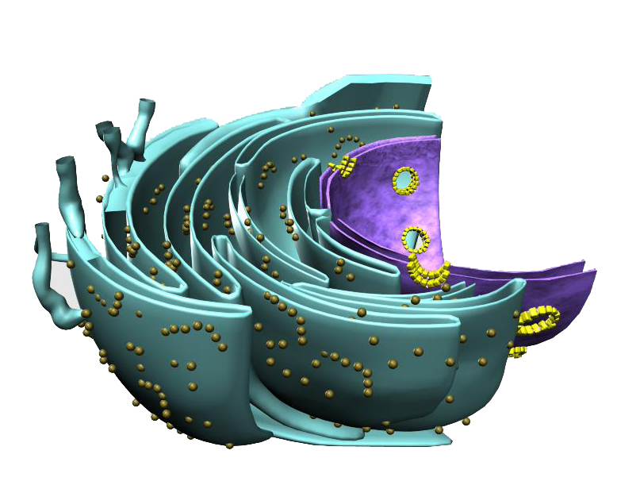
Ribosomes
made in nucleolus
can be bound to the rough endoplasmic reticulum or float freely in cytoplasm
Function to catalyze the reactions of protein synthesis

Slide 11
Endoplasmic Reticulum Structure
Network of flattened, interconnected membrane sacs (tubes and pockets)
Branches out from the nuclear envelope

Slide 12
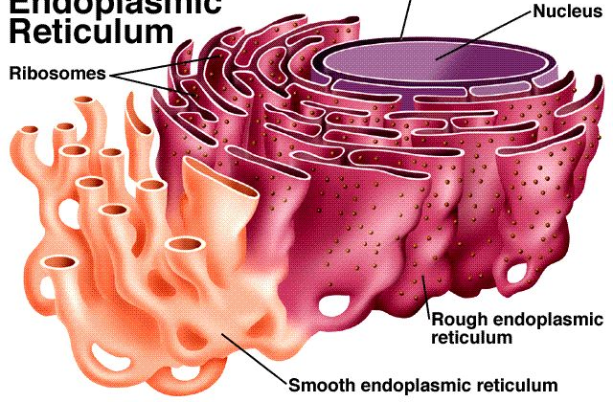
Endoplasmic Reticulum Types
Two types of ER: rough and smooth

Slide 13
Rough Endoplasmic Reticulum
Contains ribosomes on its membrane surface
Site for protein synthesis

Slide 14
Smooth Endoplasmic Reticulum
No ribosomes on its membrane surface
Site for lipid synthesis

Slide 15
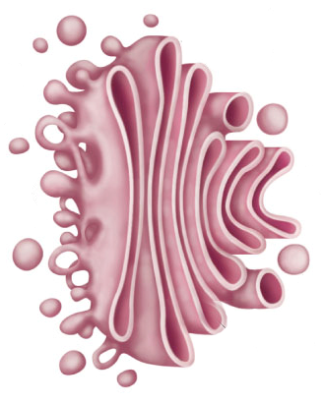
Golgi Body Structure
Flattened, stacked, interconnected membrane sacs (similar to ER)
Located near ER
Also known as the Golgi apparatus

Slide 16
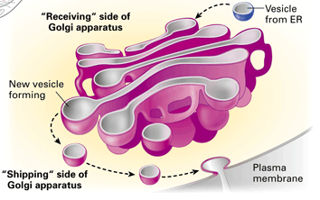
Golgi Body Function
Modifies proteins and lipids
Process materials to be removed from the cell
Make and secrete mucus
Packages products into vesicles for transport
http://4.bp.blogspot.com/_rBYpndaJ_ak/S-sxGmLUOuI/AAAAAAAAAGM/oKWwbrO41-U/s1600/Golgi+apparatus.gif

Slide 17
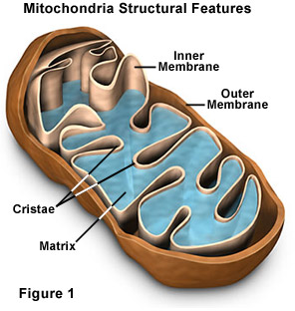
Mitochondria Structure
Surrounded by a double membrane
Inner membrane is folded to increase the surface area
Reactions occur on the inner membrane surface

Slide 18
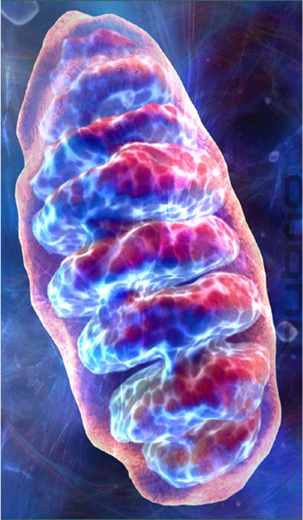
Mitochondria Function
Produces energy through a process called cellular respiration
Reaction involves converting energy from food (e.g. sugars) to cellular energy
Process requires oxygen
glucose + O₂→ CO₂ + H₂O + energy

Slide 19
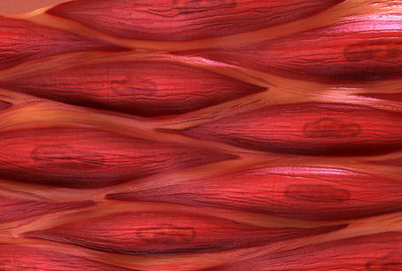
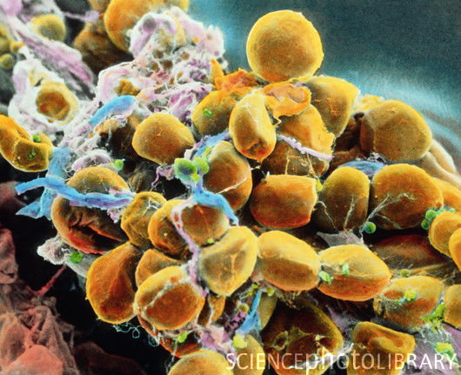
Mitochondria
Cells that are very active (e.g. muscle cells) contain many mitochondria
Cells that are fairly inactive (e.g. fat cells) only have a few mitochondria

Slide 20
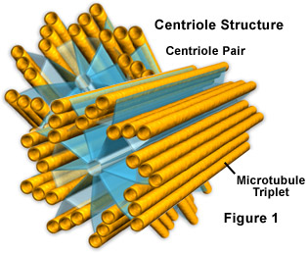
Centrioles
Comes as a pair
Found in animal cells only
Made of cylindrical tubes
Involved in cell division by organizing spindle fibers

Slide 21
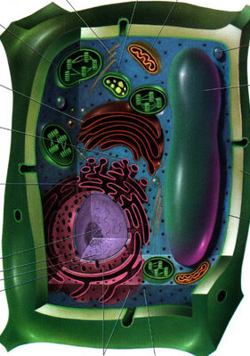
Vacuole Structure
Fluid-filled sac surrounded by a single layer of membrane
In animal cells: many small vacuoles
In plant cells: one large central vacuole

Slide 22
Vacuole Function
General:
  Storage of food, water, waste
  Removing unwanted substances from the cell
In Plants:
  Maintaining internal fluid pressure (turgor) which helps gives plants structure and strength

Slide 23
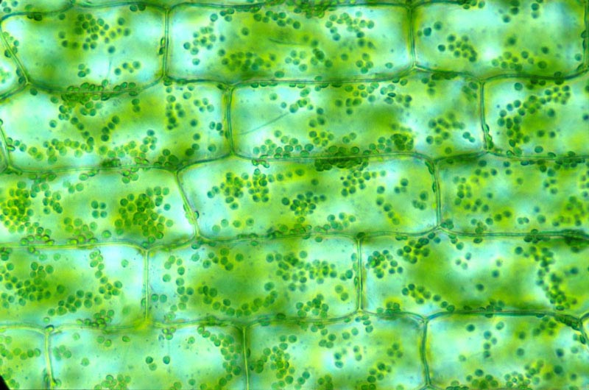
Plant Cell Organelles
Plant cells contain some organelles that animal cells do not have…

Slide 24
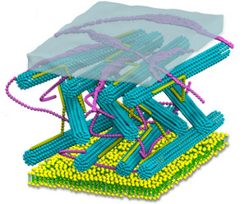
Cell Wall
Found outside of the cell membrane
Rigid but porous
Made of cellulose
Gives shape and support
Provide protection from injury

Slide 25
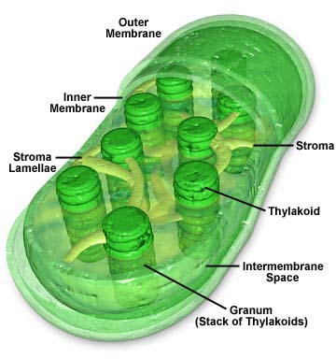
Chloroplast Structure
Surrounded by a double membrane
Contain chlorophyll, a pigment that gives plants their green colour

Slide 26
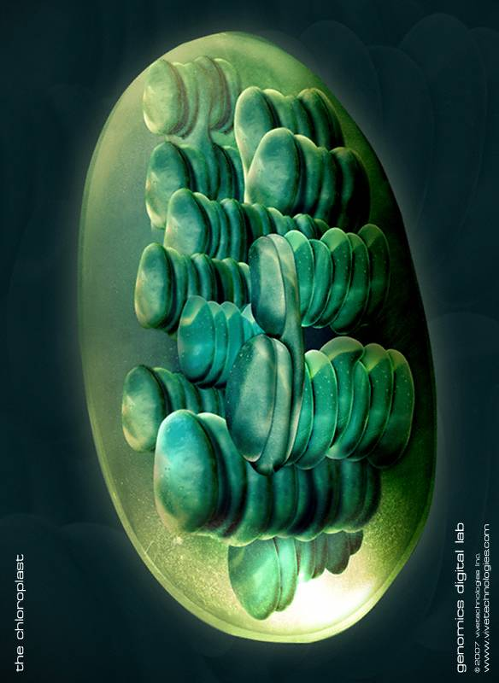
Chloroplast Function
Site for starch (a type of sugar) storage
Site for photosynthesis
Reaction involves trapping light energy to create food in the form of sugars
Starting substances are carbon dioxide and water
CO₂ + H₂O + energy → O₂ + glucose

Slide 27
Summary of Differences
Function | Animal | Plant
Outer protection | Plasma membrane | Plasma membrane Cell wall
Energy centre | Mitochondria | Mitochondria Chloroplast
Storage | Many small vacuoles | One large central vacuole

Slide 28
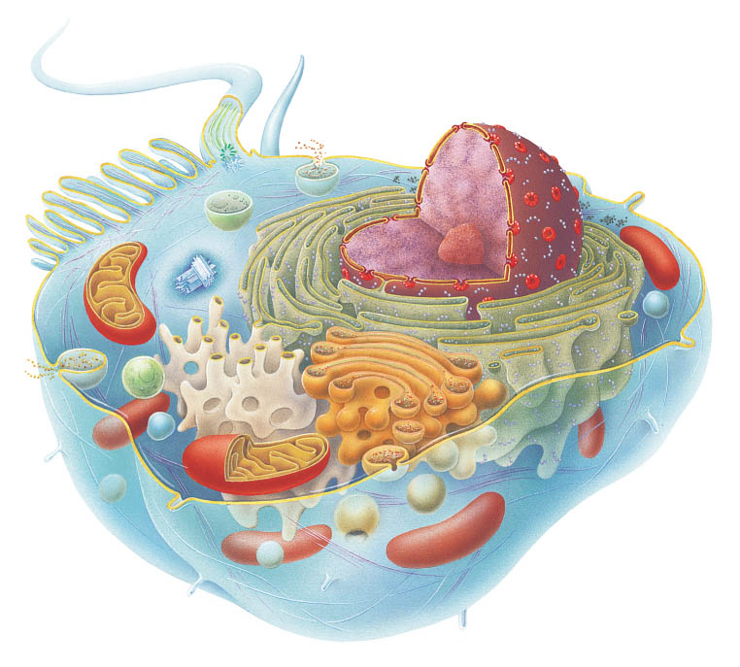
Review
How many organelles can you name?

