Slide 1
VSEPR Theory

Slide 2
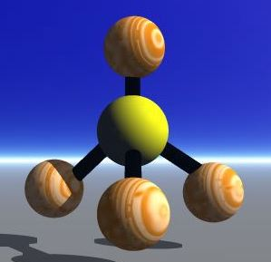
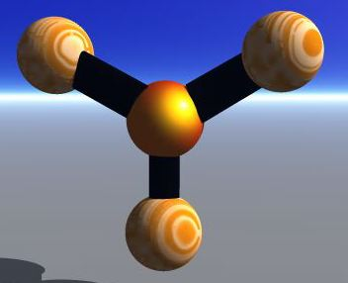
Valence shell electron pair repulsion theory.
A three dimensional representation of a molecule.
Linear
Trigonal planar
Tetrahedral

Slide 3
According to VESPR theory:
Only the valence electrons of the central atom are important for molecular shape.
Valence electrons for molecules (or polyatomic ions) are paired.
Bonded electron pairs are treated the same as lone pairs.
Valence electron pairs repel each other electro statically.
Molecular shape is determined by the electron pairs being separated as much as possible.

Slide 4
The type and number of bonds will determine the shape of the molecule.
To draw the 3-D shapes we use specific symbols to show bond directions.
Bond in plane
Bond behind plane
Bond in front of plane
Multiple bonds are considered the same as a single bond when looking at the effects on shape.

Slide 5
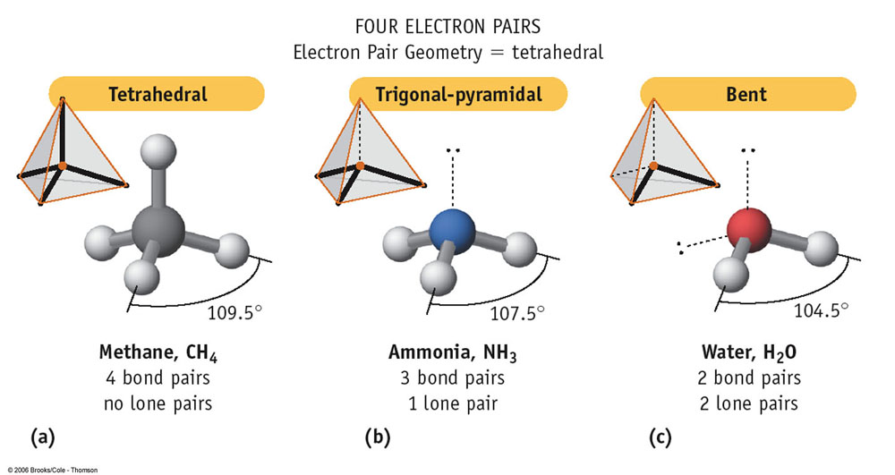

Slide 6
The hydrogens in a methane molecule are at the four corners of a tetrahedron.
The bond angles are 109.5°.
Notes:
Methane is a tetrahedral molecule. The hydrogens in methane are at the four corners of a regular tetrahedron, and the bond angles are all 109.5°. Interpreting Diagrams How do the resulting H—C—H bond angles compare to the tetrahedral angle?

Slide 7
The measured H—N—H bond angle in ammonia is only 107°.
Notes:
An ammonia molecule is pyramidal. The unshared pair of electrons repels the bonding pairs.

Slide 8
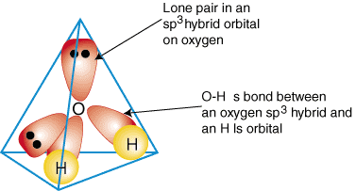
The measured bond angle in water is about 105°.
Lone Pair
Bonding Pair
Notes:
This comparison of water and carbon dioxide illustrates how unshared pairs of electrons can affect the shape of a molecule made of three atoms. a) The water molecule is bent because the two unshared pairs of electrons on oxygen repel the bonding electrons. b) In contrast, the carbon dioxide molecule is linear. The carbon atom has no unshared electron pairs.

Slide 9
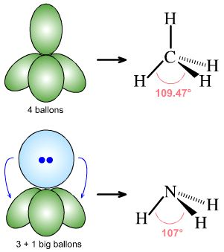
Lone pairs repel more than bonding electrons

Slide 10
Water’s bond angle is 104.5° (much less than the tetrahedral angle of 109.5°) because its lone pairs need extra room.

Slide 12
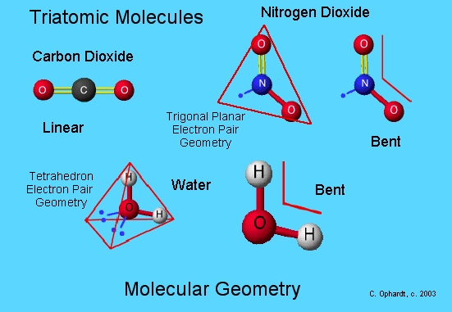
A carbon dioxide molecule is linear.
Notes:
This comparison of water and carbon dioxide illustrates how unshared pairs of electrons can affect the shape of a molecule made of three atoms. a) The water molecule is bent because the two unshared pairs of electrons on oxygen repel the bonding electrons. b) In contrast, the carbon dioxide molecule is linear. The carbon atom has no unshared electron pairs.

Slide 13
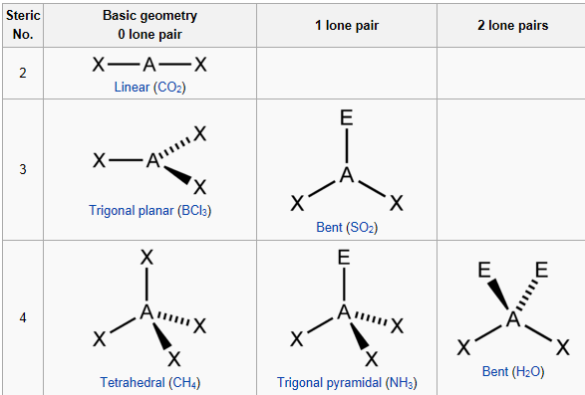
Shapes of molecules according to VESPR theory:

Slide 14
Practice
Text p. 96 # 2-4
Text p. 96 # 7

